Slide 1
Introduction
Object-Oriented Programming with C++
INFO-1156

Slide 2
Who am I?
Michael Feeney
Coordinator (and Professor)
Professors have a full teaching load. #whatfun
Coordinate CPA2, CPA3, and GDP1
mfeeney@fanshawec.ca

Slide 3
Zoom sessions (sections 4 & 5/ “D” and “E”)
Tuesdays and Thursdays
11:00-12:00 (optional) freestyle help session
12:00-2:00 The Lecture
2:00-3:00 (optional) freestyle help session
All this is recorded and will posted on FOL
To make things simpler, you will get a zoom link for an 11:00 start, but the “lecture” is only 2-3.

Slide 4
Course Information on FOL
Course outline: what the “outcomes” are:
The student will be able to do _____.
The student will be able to explain ____.
Etc.
Course plan:
The syllabus, basically.
When we are planning to do what, what’s due, when, and what it’s worth

Slide 5
Prerequistite:
Semester 3
INFO-3140 OO Analysis & Modeling
INFO-3135 Data Structures and Algorithms
Semester 4 (optional)
INFO-3111 C++ Graphics Programming (an elective with “COBOL”)
Semester 6 (optional)
INFO-5104 C++ Advanced Topics (an elective with “Emerging Technologies”)

Slide 6
Employers
They think “C/C++” is fundamental.
A C/C++ programmer can transition to other languages fairly easily, but going to C/C++ from current language – not so much.
More “close to metal”: designed more around how the computer actually works. Less abstracted. Is a “System” language, so can interact more closely with “the system”
Used in Embedded, Robotics, and Gaming, mainly
Still in the top 5 in demand languages
The “Maker” movement has increased the visibility

Slide 7
Evaluation:
In-class assessments: 10%
Midterm Exam: 25%
Projects: 30%
Final Exam: 35%
Total: 100%

Slide 8
How you get your marks
The dates for the tests and projects will be posted on Fanshawe Online
All assignments and exams involve you submitting working code to solve problems (that illustrate/demonstrate what you’ve learned)
You will be given the marking scheme in advance and likely any code I’ll use to mark it (if applicable).
Note: this may be different from other sections

Slide 9
Ask yer instructor!
Ask me about my views on cheating and collaboration. (Let’s discuss)

Slide 10
Letter Grades
A+ 90 – 100%
A 80 – 89%
B+ 75 – 79%
B 70 – 74%
C+ 65 – 69%
C 60 – 64%
D+ 55 – 59%
D 50 – 54% (a pass)
F Below 50%
Note: You must get a GPA of 2.0 (“C”) to graduate
The “must get a “C” to ‘progress” narrative is 100% NOT true.

Slide 11
Classroom Conduct
Do your homework
Learn to look up stuff (in text books and online)
Practice coding
Start projects early
Think if this were: guitar lessons or a cooking class:
Why “practice”? What would I expect you to be able to do? To “know”?
Do your own work
Plagiarism means saying it’s “your” work when it’s not.
You can have access to anything that’s online in this course
Plagiarism can result in zero for all parties involved

Slide 12
Where’s the stuff?
Mostly on FOL
Notices (dates, etc.) are posted on FOL and e-mailed to you
And discussed in class
Come to the zoom, or don’t. I get paid either way.
But you deciding to not attend means you can’t say “I didn’t know”
i.e. You’re expected to have attended/watched
github

Slide 13
Other sections:
Remember high school? Wasn’t that fun?
I (vaguely) remember it.
I also remember university and college.
I remember that if I attended “Calculus 20” in one section, I didn’t expect or insist that it was identical to other sections with other professors. Same with high school: Ms. Jone’s class was usually different that Mr. Ali’s. Right?
Same thing here. It’s not McDonalds.

Slide 14
Required Materials
Windows 10
Office 2016 or 365
Visual Studio 2019 – any version
(Not “visual studio code” – that’s a different tool)

Slide 15
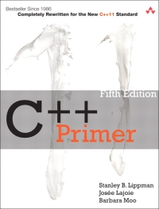
Required Text
“C++ Primer” (Paperback)
By: Stanley B. Lippman
© 2012 Addison-Wesley

Slide 16

Required Text
“Thinking in C++” (Web Published)
By: Bruce Eckel
© 2000 Prentice Hall
Two volumes written by an ISO/C++ Standards Committee member.
A lot of depth and detail.
https://archive.org/details/TICPP2ndEdVolOne
https://archive.org/details/TICPP2ndEdVolTwo

Slide 17
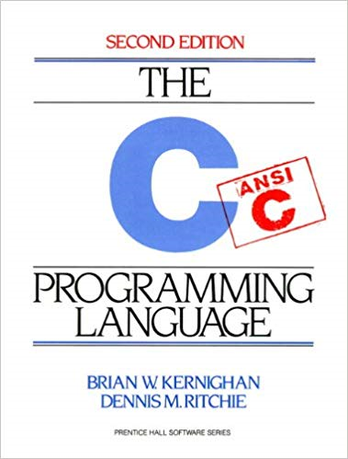
Useful Text
“C Programming Language” (2nd Edition) (Paperback)
By: Brian W. Kernighan, Dennis Richie
© 1988 Prentice-Hall, Inc.

Slide 18
C Resources
C Reference Manual (Dennis M. Ritchie)
The GNU C Reference Manual
C Standard Library Reference Tutorial (Tutorials Point)

Slide 19
C++ Resources
C++ API sites
cppreference.com
cplusplus.com
These links are available to you on FOL: Content Browser, Resources
Thinking in C++, Volume 1 and 2
Bruce Eckel
Free e-Book downloads
This link is available to you on FOL: Content Browser, Resources

Slide 20
Are you sitting down? Then let’s begin.

